Slide 1
6. Hierarchies and semantic maps
ENG 452: Linguistic Typology

Slide 2
Introduction
In our earlier lectures, we had seen the marking of grammatical relations is a central function of case, word order, and agreement but this is not the only type of information that they are utilized to depict.
In linguistics, hierarchies and semantic maps are tools used to understand relationships between linguistic elements, particularly in meaning (semantics), syntax, and morphology.

Slide 3
Under this topic, we shall look at Animacy, Definiteness, and Gender hierarchies in the study of language typology.

Slide 4
In linguistics, animacy, definiteness, and gender are structured according to hierarchies that influence grammatical patterns.
These hierarchies help explain how languages organize agreement, case marking, pronouns, and word order.
Additionally, semantic maps illustrate how meanings are related between categories across languages.

Slide 5
In many languages, morphology and syntax can also be exploited to underscore the degree of animacy, the definiteness, the person (first, second, or third), or the gender of noun phrases.

Slide 6
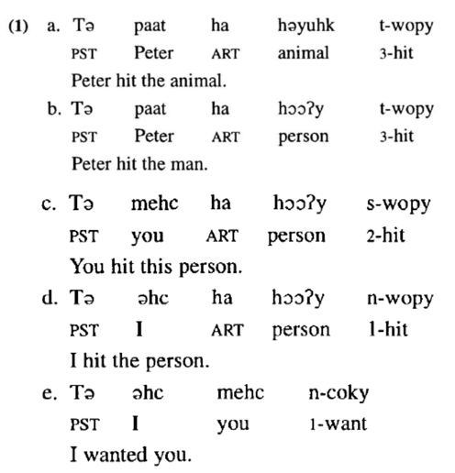
This, for example, is true of Mixe (pronounce as /maiks/) (Penutian: Southern Mexico): (Data from Lyon 1967)
The order of the sentence:
Tense_Subj_Art_Obj_SubjAgr-Verb

Slide 7
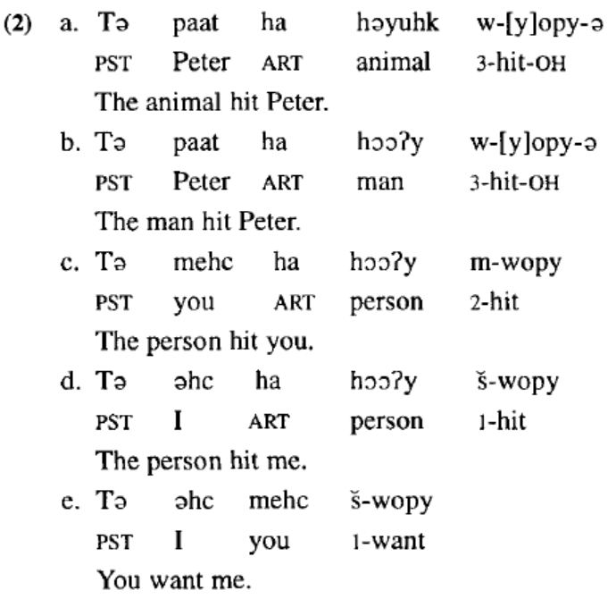
Mixe (Penutian: Mexico):
The order of the sentence:
Tense_Obj_Art_Subj_ObjAgr-Verb
PST means past tense marker
OH means Object higher in Animacy scale, so it occurs first (before the subject occurs) in this language

Slide 8
Putting together examples 1 and 2
SOV OSV

Slide 9
At first glance, the data in (1) and (2) appear to exhibit a pattern of verb agreement that is somewhat arbitrary, particularly if one expects to find agreement based on notions such as subject and object.
If we focus solely on the data in (1), we might analyze the basic constituent order as being subject-object-verb (SOV) and claim that verbs agree with subjects.
The data in (2), however, violate these generalizations.
In (2e), like all the examples in (2), the word order is OSV, and the agreement is with the object.
Moreover, in (2a) and (2b) the suffix -ə arises on the verb; this marker, however, occurs in no other clause in the data.

Slide 10
The properties of the nominals (nouns) other than their grammatical relations are determining the operation of agreement in Mixe language.
To adequately describe what is occurring in the Mixe data, one must first realize that both constituent order and agreement are sensitive to the relative "animacy" of the participants in the clause.
In simple transitive clauses, the verb agrees with the nominal that possesses the higher animacy, and this nominal is positioned first.
In Mixe, humans are rated as being more animate than animals (cf. (la) and (2a)),
proper nouns more animate than common nouns (cf. (lb) and (2b)),
both first and second person more animate than common nouns (cf. (lc) and (Id) to (2c) and (2d)),
first-person pronouns more animate than second-person pronouns (cf. (le) and (2e)).

Slide 11
1. Animacy Hierarchy
But first what is hierarchy?
A hierarchy is when things are arranged in order of importance.
A settlement hierarchy puts settlements in order.
This can be done in three ways:
1. The size of each settlement (main way)
2. The number of settlements and the distance between
them (smaller number = higher order)
3. The number of services a settlement has. A top order settlement three hospitals, lots of jewellery
shops etc., whilst a low order settlement might only have a Post office nearby.

Slide 12
But In linguistics
Animacy refers to how "alive" or "sentient" (able to perceive or feel things) a noun is.
Many languages use an animacy hierarchy to determine how nouns behave in grammar (e.g., case marking, verb agreement, pronoun usage).
By setting up an animacy hierarchy for Mixe, it is possible to state simply that the more animate nominal is placed before the less animate nominal, and the verb agrees with the nominal of higher animacy.

Slide 13
Similar phenomena is also found in other languages.
Hence, it has been proposed (e.g., Silverstein 1976) that there is a universal Animacy Hierarchy.
1 & 2 person > 3 person pronoun > proper name/kin term > human NP > animate NP > inanimate NP

Slide 14
Animacy Hierarchy (from most animate to least animate):
1. First-person pronouns ("I," "we")
2. Second-person pronouns ("you")
3. Third-person pronouns ("he," "she," "they")
4. Proper names ("Alice," "John")
5. Human nouns ("teacher," "child")
6. Higher animals ("dog," "elephant")
7. Lower animals ("ant," "worm")
8. Natural forces ("wind," "storm")
9. Inanimate objects ("rock," "table")
10. Abstract concepts ("justice," "love")

Slide 15
Effects of the Animacy Hierarchy
In some languages (e.g., Hindi, Japanese), higher-animate nouns take different case markings than inanimate nouns.
Many languages (e.g., Russian, Ojibwe) have differential object marking (DOM) where animate objects require special markers.
Subject-verb agreement often follows animacy (animate subjects tend to control verb agreement more than inanimates).

Slide 16
Extended Animacy Hierarchy:
first/second p < person pronouns < third person pronoun < proper names < human common noun
< nonhuman animate common noun < inanimate common noun
This combination of features has been named the ‘animacy hierarchy’.
Since semantic animacy is only part of the hierarchy, we will call it the extended animacy hierarchy.
(Dixon 1979:85; Silverstein 1976).

Slide 17
The extended animacy hierarchy actually involves three distinct but related functional dimensions:
(1a) Person: first, second < third
(1b) Referentiality: pronoun < proper name < common noun
(1c) Animacy: human < animate < inanimate
The first is a person hierarchy, in which first and second person outrank third person.
The second is a referentiality hierarchy, in which pronouns outrank common nouns (there is some evidence that proper names occupy an intermediate position on this hierarchy).
Finally, there is the animacy hierarchy proper, in which humans outrank nonhuman animates, which in turn outrank inanimates.

Slide 18
Several comments need to be made at this juncture with respect to the Animacy Hierarchy.
First, the hierarchy is structured by a sociocentric orientation this captures the notion that speakers and writers tend to place most importance on themselves and those listening to them (i.e., those who generally are referred to in the second person).
Second, the hierarchy assigns primacy to nominals with which speakers and writers are familiar or have empathy. During the formation of a discourse, the participants are aware of themselves and of each other. Thus, those involved with the immediate speech act (first and second persons) will again be ranked highest on this parameter. Third-person pronouns represent an entity that both speaker and hearer are able to uniquely identify in their minds, and so here too there must be a certain awareness or empathy toward such entities. Similarly, proper names require more familiarity among interlocutors and, therefore, involve greater empathy than do other noun phrases referring to humans.

Slide 19
Finally, definiteness plays a role in the structuring of the hierarchy. Pronouns and proper names are always definite. When one uses the pronoun he, for instance, it cannot properly refer to an indefinite entity such as a doctor. Because human noun phrases are more likely to be central to discourse than nonhuman noun phrases, they are also more likely to be definite. The same is true of animate (as opposed to inanimate) nominals.

Slide 20
A final point in regard to the Animacy Hierarchy that must be clarified is that the first category on the hierarchy (first and second person) cannot be further broken down on a universal basis.
Individual languages, however, often select one or the other member of this category as bearing a higher degree of animacy.
As shown previously, Mixe language places first person before second.
Other languages may treat first and second person equivalently, and still others may place second person before first person.

Slide 21
Reflexes of Animacy in Morphology and Syntax
The particular ways in which animacy is reflected in morphology and syntax differ from language to language, but certain realms of grammar are more likely to make formal distinctions based on distinctions drawn from the Animacy Hierarchy.
One such area is verbal agreement, which was exemplified in (1) for Mixe language. (refer to the previous slides on Mixe language data)

Slide 22
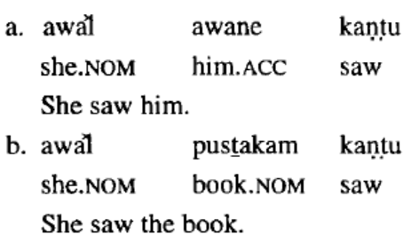
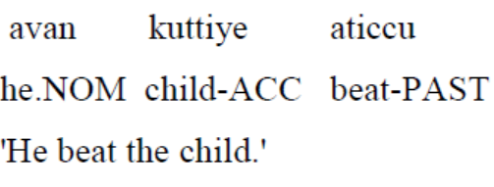
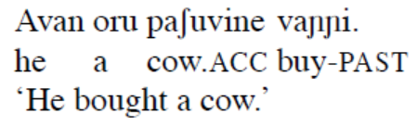

Similarly, case marking can be sensitive to animacy.
Malayalam
The direct objects in Malayalam (Dravidian) are put in the accusative case when they are animate (1a), but they are put in the nominative (morphologically no marking) if they are inanimate (1b). (see Mohanan 1982)
Malayalam has different accusative case marker forms for different nouns based on animacy, definiteness, or specificity of the direct object (differential object marking = DOM).
(1)

Slide 23
2. Definiteness hierarchy
Another hierarchy that turns out to be closely associated with animacy, particularly with the coding of objects, is the definiteness hierarchy:
Definiteness: definite < specific < nonspecific
Definite referents (i.e. those whose identity is known to both speaker and hearer) outrank specific indefinite referents (a specific instance or token whose identity is unknown to the hearer and possibly also the speaker), which in turn outrank nonspecific referents (those identifiable only as a type, not as a specific instance or token).

Slide 24
Definiteness Hierarchy (from most to least definite):
1. Personal pronouns ("I," "you," "he")
2. Proper names ("Alice," "Tokyo")
3. Definite noun phrases ("the book," "that dog")
4. Indefinite specific noun phrases ("a certain book," "some dog")
5. Indefinite non-specific noun phrases ("any book," "any dog")
6. Bare nouns (general reference, "books are useful")

Slide 25
Effects of the Definiteness Hierarchy
In English, definite articles ("the") appear at a higher level, while indefinite articles ("a") mark lower definiteness.
In some languages (e.g., Hebrew, Arabic), definiteness affects agreement and case marking.
Object marking is sometimes affected: in languages like Turkish and Persian, definite objects require a preposition.
So also true or Malayalam, Hindi,

Slide 26
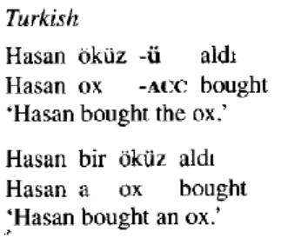
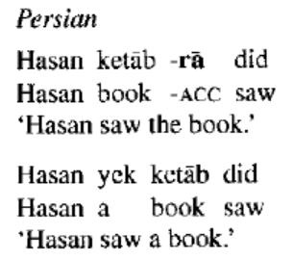
Definiteness plays a role by itself in the overt coding of direct objects.
In Turkish and Persian, definite direct objects take the overt accusative case affix (Comrie 1989:132-33):

Slide 27
In fact, the animacy hierarchy and definiteness hierarchy interact in the coding of direct objects.
Hindi is one such example. (Recall, we have also seen example from Malayalam)
In Hindi, object marking, specifically the use of the "ko" marker, is influenced by two factors: animacy and definiteness/specificity.
with animacy generally being the primary trigger for marking human objects, while definiteness/specificity plays a role for inanimate objects.

Slide 28
In Hindi, human objects have to be obligatorily marked with ko.
When a human object is marked with this object marker, it can be interpreted as definite or indefinite. When a human object occurs without ko this results in an ungrammatical sentence.
This contrast is shown in (1) and (2) for the noun ‘child’.
HINDI example: (Mohanan 1990:103)
(1) ilaa-ne bacce-ko uthayaa
Ila.F-ERG child.M-ACC lift.PERF. M.SG
‘Ila lifted the/a child.’
(2) *ilaa-ne baccaa uthayaa
Ila.F-ERG child lift.PERF.M.SG
Indented: ‘Ila lifted the/a child.’

Slide 29
In the absence of a determiner, inanimate nouns, on the other hand, can either be marked with ko or be left unmarked.
The use of ko does have repercussions for the interpretation associated with the direct object.
An unmarked inanimate can be interpreted as definite or indefinite, as is shown in (3).
(3) ilaa-ne haar uthaayaa
Ila.F-ERG necklace.M lift.PERF.M.SG
‘Ila lifted a/the necklace.’ (Mohanan 1990:103)
Definiteness of an inanimate noun is expressed by using ko.
This is shown for the noun ‘necklace’ in (4) below.
(4) ilaa-ne haar-ko uthayaa
Ila.F-ERG necklace.M-ACC lift.PERF.M.SG
‘Ila lifted the/*a necklace.’ (Mohanan 1990:103)
The DO bacce ko ‘child’, as in (1) and (2) is animate and usually marked,
whereas haar ‘necklace’ is inanimate and only marked when the interpretation is definite ‘the necklace’, marked by ko, as in (4).

Slide 30
The unmarked DO haar in (3) can be interpreted in three possible ways:
1) As a definite object ‘the necklace’,
2) as an indefinite specific object, which renders a translation with the indefinite determiner in English
referring to a necklace known to the speaker (e. g. ‘Ila lifted a necklace [of those that were presented
there]’),
3) as an indefinite nonspecific object ‘a necklace’.

Slide 31
The marking of the inanimate object depends on the definiteness or specificity of the object.
Unmarked inanimate objects can be interpreted as both definite and specific or indefinite and nonspecific,
but when the inanimate object is marked with ko, it can only be interpreted as definite and/or specific.

Slide 32
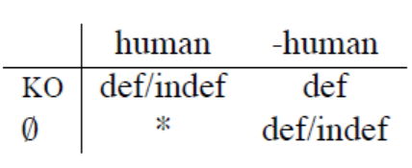
The above examples show that both animacy and definiteness play a role in differential object marking (DOM) in Hindi.
Their roles are, nevertheless, clearly differentiated.
Consider the table in (5).
(5)

Slide 33
So, in Hindi, direct objects that are human are almost always flagged by the postposition (accusative marker) ko regardless of whether they are definite.
Only in rare cases will human referents appear without ko, and when they do, they are indefinite.
Definite nonhuman nominals also typically take ko.
However, indefinite nonhuman nominals never do.

Slide 34
The Role of Animacy in Hindi
Generally, animate arguments are marked with ko, as shown below.
(6) ilaa-ne bacce-ko uthayaa [repeated from eg. 1]
Ila.F-ERG child.M-ACC lift.PERF. M.SG
‘Ila lifted the/a child.’
This is especially the case with animate arguments that are human (Kachru 2006: 175).
For animate non-human arguments—one thinks in particular of animals—the rule is less strict.
For instance, consider the following example (4), in which cuhī ‘mouse’ is not marked with ko.
(7) billī cuhī khāegī
cat.f.sg mouse.f.sg eat.fut.f.sg
‘The cat will eat the mouse.’
In general, though, animate arguments, even non-human, are much more likely to be marked with ko than inanimate arguments

Slide 35
3. Gender: Definiteness and Gender
There are two further semantic properties of nouns that can govern the manner in which they are treated in the morphology and syntax of languages: definiteness and gender.

Slide 36
The significance of definiteness. In some language, definiteness is important.
Example, in Abkhaz language (Northwest Caucasian: Turkey), the object agreement is sensitive to whether or not the object is definite.
The definiteness of a nominal may determine, in part, whether it triggers agreement or what form the agreement takes.
(1) a. Kassa borsa-w-in wässädä-w
Kassa wallet-the-OBJ took-it
‘Kassa took the wallet.’
b. Kassa borsa wässädä-
Kassa wallet took.
‘Kassa took a wallet.’ (Data from Givon 1976)
Abkhaz uses an agreement system that is sensitive to the definiteness of direct objects.
If they are definite, an agreement suffix is used (1a); otherwise, no suffix appears (1b).

Slide 37
A similar effect is found in case marking in some languages. In Hebrew (Semitic: Israel), only
definite objects are flagged by the clitic et- (2).
(2) a. ha-ish koteb dabar
ART-man write word
‘The man is writing a word.
b. ha-ish shomer et-ha-torah
ART-man observe DEF-ART-law
‘The man is observing the law.’

Slide 38
Definiteness and animacy often interact.
Comrie (1989) presents Hindi (Indo-Iranian: India) as a revealing case study.
In the language, direct objects that are human are almost always flagged by the postposition ko regardless of whether they are definite.
Only in rare cases will human referents appear without ko, and when they do, they are indefinite.
Definite nonhuman nominals also typically take ko.
However, indefinite nonhuman nominals never do.

Slide 39
Thus, neither the human-nonhuman nor the definite-indefinite distinction is sufficient to determine the distribution of ko. Rather, the interaction of the two semantic categories is required (3).
(3) Definite Indefinite
Human ko (required ) ko (almost always)
Nonhuman ko (typical) —
The interchange between animacy and definiteness should not come as a surprise. Recall that one of the parameters on which the Animacy Hierarchy is based is definiteness.

Slide 40
The gender of a nominal is another property of nominals that can influence the grammar of a language (see Corbett 1991).
Pronouns, for example, often reflect gender distinctions, such as the third-person singular set in English (he, she, and it). BUT not in Hindi.
Noun classes are commonly sensitive to gender as well—for example, in French,
female entities tend to be marked by feminine gender and male entities by masculine gender.
Eg.
Definite Articles:
"le" (masculine singular) - e.g., le livre (the book)
"la" (feminine singular) - e.g., la table (the table)
Indefinite Articles:
"un" (masculine singular) - e.g., un livre (a book)
"une" (feminine singular) - e.g., une table (a table)

Slide 41
In addition to lexical classification, the morphosyntax of languages can reflect gender distinctions.
In Russian (Balto-Slavic: Russia), for example, verbs display gender agreement in the past tense:
(4) a. babuska citala vs Dedushka chital
grandmother.FEM read.FEM grandfather.MAS read.MAS
‘Grandmother was reading.’ ‘Grandfather was reading.’
b. tot celovek cital vs zhenshchina citala
the man.MSC read.MSC woman.FEM read.FEM
‘The man was reading.’ ‘The woman was reading.’
c. okno otkrylos
window.NEUT open, itself, NEUT
‘The window opened.’ (Data from Moravcsik 1978)
In this particular case, the influence of gender is indirect because the verb is actually agreeing with noun classes (which are labeled "feminine," "masculine,“ and "neuter") rather than the sex of the nominal referents per se. Nevertheless, the importance of gender is apparent.

Slide 42
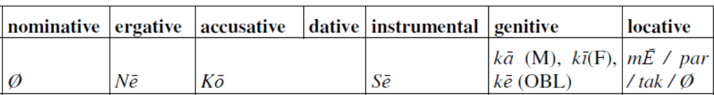
Hindi is characterized by possessing a special agentive marker, i.e. the subject is morphologically marked with the (postpositional) ergative -nē in all persons and numbers in the perfective domain.
The noun forms of Hindi shows features of gender (masculine and feminine), number (singular and plural), and case.
In Hindi, gender does not determine marking on the object, but it affects verb agreement.
Hindi has two grammatical genders:
Masculine (M) → Takes -a ending
Feminine (F) → Takes -i ending
Also, recall that there are seven cases in Hindi (Butt & King 2004: 157), among which that object takes an accusative marker -ko.

Slide 43
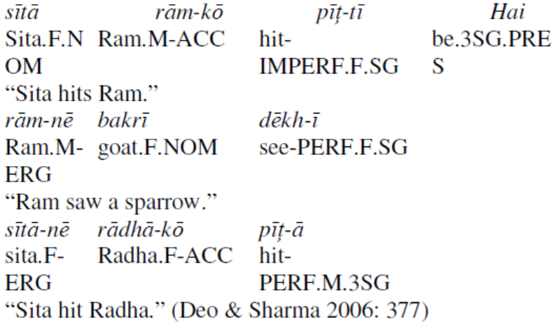
The (finite) main verbs in Hindi show agreement only for number (singular and plural) and gender (masculine and feminine), but not for person. (see Mirdehghan, 2013: 64-66).
(1a)
(1b)
(1c)

Slide 44
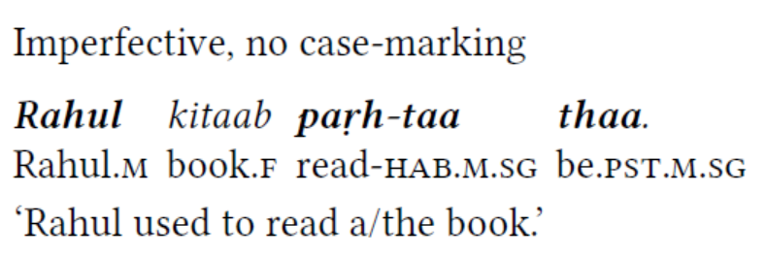
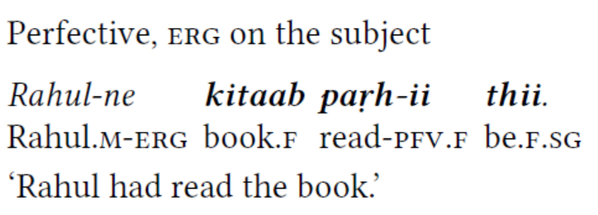
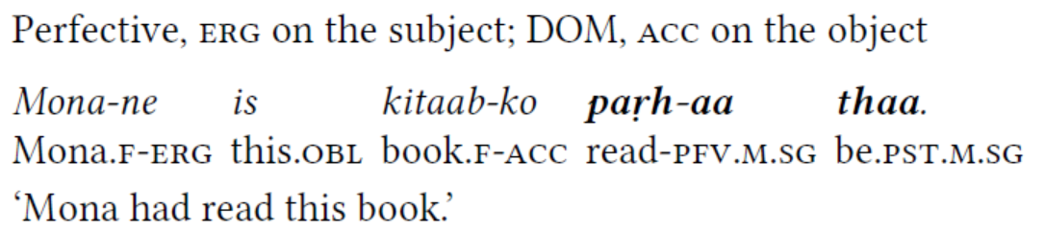
More examples from Hindi (Bhatt 2005: 759, 768)
a)
b)
c)

Slide 45
More Hindi examples from Hindi/Urdu are (Kachru 1966: 42):
(1a) laķkā Kitāb paŗh-tā hai (transitive sentence)
boy.M.NOM book.F read- IMPERF.M.SG be.3SG. PRES
“The/A boy reads the book.”
(1b) laķkā-nē Kitāb paŗh-ī
boy.M-ERG book.F read- PERF.F.SG
“The/A boy read the book.” (past perfective)
(2a) laķkā ĵā-tā hai (Intransitive sentence)
boy.M.NOM go-IMPERF.M.SG be.3SG.PRES
“The boy goes.”
(2b) laķkā ga-yā
boy.M.NOM go-PERF.M.SG
“The boy went.”

Slide 46
Mona-ne is kitaab-ko parh-aa thaa
Mona.f-erg this.obl book.f-acc read-pfv.msg be.pst.msg
‘Mona had read this book.’

Slide 47
Now, to conclusion

Slide 48
The Animacy Hierarchy (Silverstein 1976) is a universal ranking that influences object marking:
1st-person pronouns (I, we)
2nd-person pronouns (you)
3rd-person pronouns (he, she, they)
Proper names (John, Maria)
Human nouns (man, woman)
Animate nouns (dog, cat, bird)
Inanimate nouns (rock, table, book)
Effects on Object Marking
Languages tend to explicitly mark objects that are high in animacy but may leave unmarked those that are lower (especially inanimate objects).

Slide 49
In Hindi,
Animate direct objects (humans, animals) typically require ko.
Inanimate direct objects remain unmarked.
Sentence Meaning Object Marking
Maine larke ko dekha. “I saw the boy.” - ko is used (animate)
Maine kutte ko dekha. “I saw the dog.” -ko is used (animate)
Maine kitaab padhi. “I read the book.” -no ko (inanimate)
Maine darwaza khola. “I opened the door.” -no ko (inanimate)

Slide 50
Definiteness and Object Marking
Definiteness affects how objects are marked across languages:
Personal pronouns (I, you, he)
Proper nouns (John, Paris)
Definite NPs (the book, that dog)
Specific indefinite NPs (a certain book)
Non-specific indefinite NPs (any book, some book)
Effects on Object Marking
Definite and specific objects tend to receive overt case marking, while indefinite and nonspecific objects may remain unmarked.

Slide 51
Definite vs. Indefinite Objects in Hindi
In Hindi, definite objects (specific) are more likely to take ko, while indefinite objects (non-specific) often remain unmarked.
Sentence Meaning Object Marking
Maine larke ko dekha. “I saw the boy.” (specific) -ko is used (definite)
Maine ek larka dekha. “I saw a boy.” (indefinite) -no ko
Maine us aadmi ko dekha. “I saw that man.” (definite) -ko is used
(Maine koi aadmi dekha. “I saw some man.”(indefinite) -no ko
Observation:
Definite and specific objects tend to be marked with ko.
Indefinite objects generally remain unmarked.

Slide 52
Gender and Object Marking
Gender as a Marked Feature
In many languages, gender interacts with object marking, especially in agreement systems.
More prominent (human, animate, definite) nouns are more likely to have gender-based agreement.
Gender distinctions are common in pronouns and agreement systems but rare in DOM per se.
In Hindi, gender does not determine the presence of DOM, but it affects verb agreement.
Hindi has two grammatical genders:
Masculine (M) → Takes -a ending in adjectives/participles.
Feminine (F) → Takes -i ending in adjectives/participles.

Slide 53
Gender Agreement with Marked and Unmarked Objects
Sentence Meaning Object Marking Verb Agreement
Maine larke ko dekha. “I saw the boy.” -ko used Seen verb (M)
Maine ladki ko dekha. “I saw the girl.” -ko used Seen verb (M) (default)
Maine kitaab padhi. “I read the book.” -no ko Read verb (F)
Observation:
If ko is present, the verb takes masculine singular default agreement (dekha).
If no ko is present, the verb agrees with the object’s gender (padhī for kitaab "book" (F)).

Slide 54
Interaction of Animacy, Definiteness, and Gender in Hindi
Sentence Meaning Animacy Definiteness Gender -Ko Present?
Maine larke ko dekha “I saw the boy.” Animate Definite M Yes
Maine ek larka dekha.) “I saw a boy.” Animate Indefinite M No
Maine ladki ko dekha “I saw the girl.” Animate Definite F Yes
Maine kitaab padhi.) “I read the book.” Inanimate Definite F No
Maine darwaza khola. “I opened the door.” Inanimate Definite M No

Slide 55
Animacy: Animate objects (humans, animals) require ko, while inanimates usually do not.
Definiteness: Definite objects tend to be marked with ko, while indefinite objects remain unmarked.
Gender: Gender affects verb agreement but not object marking.
Thus, Hindi Differential Object Marking (DOM) follows a predictable pattern where animacy and definiteness are the primary factors, while gender affects verb agreement rather than object marking.

Slide 56
References
Croft, William. 2003. Typology and universals (second edition). Cambridge: Cambridge
University Press.
De Swart, P., & de Hoop, H. (2007). Semantic aspects of differential object marking. In Proceedings of Sinn
und Bedeutung (Vol. 11, pp. 598-611).
Mirdehghan, M. 2013. Ergative case & agreement marking: similarities and variations in hindi/urdu,
pashto and balochi languages. Dialectologia: revista electrònica, 59-86.
Whaley, Lindsay J. 1996. Introduction to typology: the unity and diversity of language. London: Sage.

